Slide 1
___________________
Springbrook Estates Sewer Improvement Area
Informational Meeting
December 20, 2017
Presented By:
Allen County Sanitary Engineering Department
___________________

Slide 2
Overview Of Tonight’s Meeting
Project Introduction
Meeting Objective
Project History
Proposed Sanitary Sewer Layout
Procedure for Completion of Project
Estimated Cost to Property Owners
Easement Acquisition
Tentative Project Schedule
Questions

Slide 3
1. Project Introduction
A public sanitary sewer project is proposed for the Springbrook Estates Sewer Improvement Area. The project is being initiated due to the following:
1) There is an existing health concern and water pollution hazard as documented by our department and the Allen County Health Department.
Resident complaints.
Failing on-lot systems.
Since the meeting held August 28, 2013 the department has been researching financial assistance opportunities, completing detailed plans and specifications for the project.

Slide 4
2. Meeting Objective
This meeting will provide information for completion of a sanitary sewer project serving approximately 84 property owners located within Springbrook Estates, Northwest Street, SR 65 and SR 115 areas. The meeting will also allow for a question and answer period following the presentation.

Slide 5
3. Project History
October 6, 2011 Sampling and testing of ditches and catch basins were completed by the Allen County Health Department and Allen County Sanitary Engineering Department.
May 15, 2012 Sampling and testing of ditches and catch basins were completed by the Allen County Health Department and Allen County Sanitary Engineering Department.
July 13, 2012 The Allen County Board of Health made recommendation to the Board of County Commissioners to pursue the installation of public sanitary sewer to eliminate the existing public health issues and water quality violations.
August 28, 2013 Conduct public Informational Meeting.
August 28, 2013 to Complete detailed plans, specifications, complete Tonight income surveys and research financial assistance options.
December 20, 2017 Conduct 2nd Informational Meeting

Slide 6
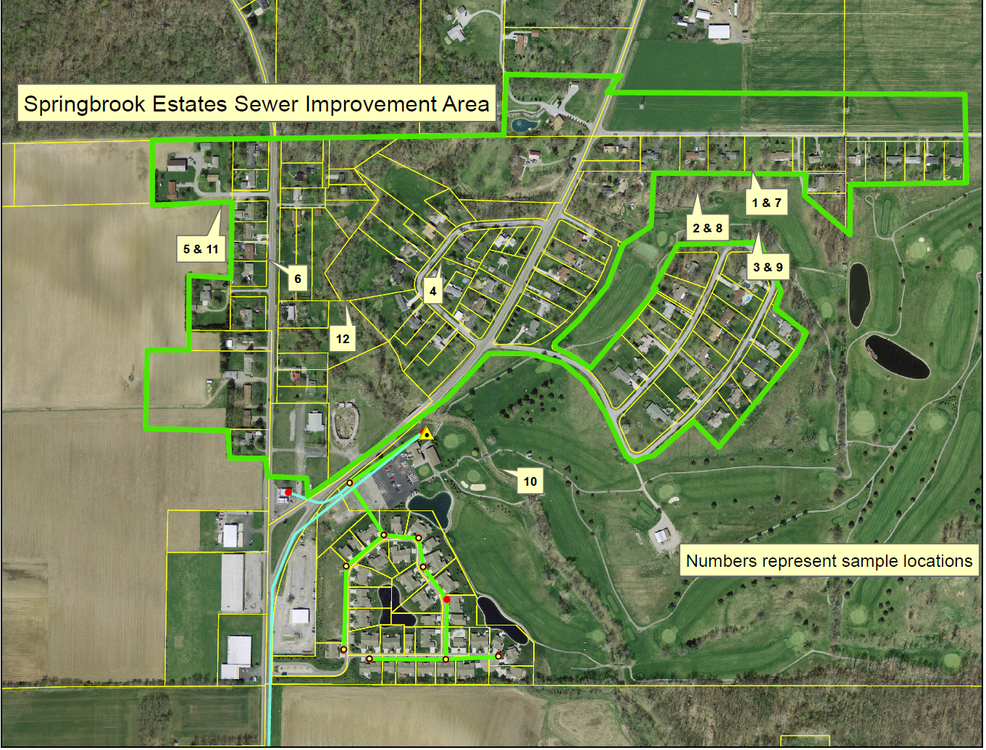
3. Project History – Sampling Locations

Slide 7
3. Project History – Sampling Test Results

Slide 8
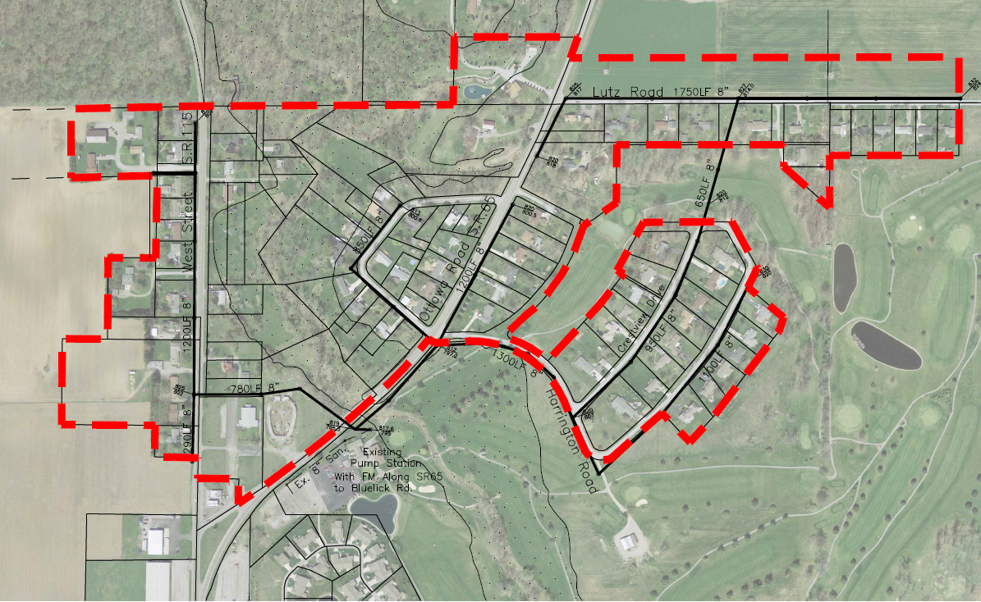
4. Proposed Sanitary Sewer Layout

Slide 9
5. Procedure for Completion of Project
Conduct 1st Informational Meeting on August 23, 2013.
ORC 6117.06(A) - Commissioners adopted Resolution 523-13 on August 28, 2013 approving General Plan and Declaring Necessity of project.
Research and make funding assistance applications.
Conduct 2nd Informational Meeting on December 20, 2017.
Proceed to the construction of the project once County has received Closing Instructions from USDA.
Complete construction of the project.
Finalize cost of project, mail billings with notice of Project Wrap-up Meeting to property owners.
Conduct Project Wrap-up Meeting addressing property owner concerns, final billing and connection process.
Notify property owners for connection to the project. Health Department will require in-house plumbing inspection before connection.

Slide 10
6. Estimated Cost to Property Owners
Cost to property owners can be broken down as follows:
Cost for design and construction of sanitary sewer mainline paid back as a monthly debt service to be added onto the sewer bills.
Miscellaneous out-of-pocket cost:
Abandonment of septic and connection to sanitary sewer.
County sewer bill with debt service charge.
County Health Board permit and potential modifications to plumbing.

Slide 11
6. Estimated Cost to Property Owners (cont.)
Funding Assistance Sources:

Slide 12
6. Estimated Cost to Property Owners (cont.)
Estimated Principal Debt Service
Estimated Total Project Cost Breakdown:
Construction (9,581 lf of sewer) $1,239,746
Design 167,400
Easement acquisition 20,000
Administrative 44,000
Miscellaneous 43,000
Contingency (10% Construction Cost) 123,976
Total $1,638,122
Estimated Principal Debt Service (PDS) per User Equivalency (UE):
PDS per UE = (PDS – USDA Grant – County Participation) ÷ 84 UE
=($1,638,122 - $400,000 - $405,800) ÷ 84 UE
=$832,322 ÷ 84 = $9,909 per UE
Note: The $9,909 principal debt service may be paid in cash within 30-days of billing.

Slide 13
6. Estimated Cost to Property Owners (cont.)
Estimated Principal Debt Service
Summary of Principal Debt Service Broken-down into a Monthly Charge:
Principal Debt Service = $9,909, Interest Rate = 2.75%
 | 20-year repayment | 30-year repayment | 40-year repayment
Monthly Debt Service | $53.95 | $40.60 | $34.17
Payback | $12,948 | $14,616 | $16,402
Additional Financing Cost Over 20-year Plan | - | $1,668 | $3,454

Slide 14
6. Estimated Cost to Property Owners (cont.)
Estimated Out-of-Pocket Cost to Property Owners
Abandonment of existing private sewage system/tanks and
installation of a sanitary sewer lateral to the project.
Approximate Cost - $1,500 to $2,000.
Once a property owner has connected to the sewer line he or she will receive a quarterly sewer bill which may be billed monthly EFT.
Month’s Billed | Billing Date | Due Date | Cost
Jan-Feb-Mar | May | June | $148.50
Apr-May-June | Aug | Sept | $148.50
July-Aug-Sept | Nov | Dec | $148.50
Oct-Nov-Dec | Feb | March | $148.50
Allen County Board of Health Permit ($100 to be covered in project cost), and any plumbing modifications

Slide 15
6. Estimated Cost to Property Owners (cont.)
SUMMARY OF ESTIMATED COST
Principal DS | Monthly DS Charge to be billed with sewer bill (40 yr-20yr) | On-Lot out-of-pocket | Quarterly Sewer Bill (monthly)
$9,909 | $34.17-$53.95 | $1,500-$2,000 | $148.50 ($49.50)
The total monthly sewer bill is estimated to be between $83.67 (40-year) to $103.45 (20-year).

Slide 16
7. Easement Acquisition
USDA will not allow the County to proceed with bidding the sewer improvement until all easements have been secured. The climate for receiving the best bid pricing is now.
Therefore, in an effort to obtain the best possible pricing for construction the County needs to wrap-up the easement acquisition process. Your cooperation working with our representatives is greatly appreciated. All property owners will benefit from a lower final project cost. All savings will be passed along to the property owners.
There are a few easements that have not been secured from property owners. However, checks are being created for all property owners that have signed easements. Checks and copies of recorded easements shall be mailed to all property owners.

Slide 17
8. Tentative Project Schedule
1st Informational Meeting | August 28, 2013
Income Surveys Sent Out | January 24, 2014
2nd Informational Meeting | December 20, 2017
Begin Construction | February-March 2018
Complete Construction | December 2018
Project Wrap-up Meeting | January 2019
Initial Principal DS Billing | February 2019
First DS Billing on Sewer Bill | April 2019

Slide 18
Questions

