Slide 1
GOMER SEWER IMPROVEMENT AREA
Project Update
March 15,2022
Allen County Sanitary Engineering Department
3230 North Cole Street
Notes:
Introduction.

Slide 2
Overview of Update
History Update of Project
Project Layout & Pump Information
Project Cost, Funding Assistance and Financing
Easement Acquisition
Post-Construction Connection Procedure
Next Steps and Tentative Schedule
Notes:
What we will cover tonight.

Slide 3
I. History of Project
    During 2010 - OEPA obtained stream samples within the Gomer area. The results of the samples confirmed an excess level of E-coli present and that nuisance conditions existed indicating violations of water quality standards.
July 10, 2012 - OEPA sent a letter to the Allen County Commissioners regarding their findings in the Gomer area. OEPA requested the Commissioners respond in writing as to how the water quality violations will be addressed.
September 20, 2012 - July 15, 2013, July 29, 2013 and August 5, 2013: Allen County conducted additional Pike Run stream testing to determine the scope of the problem and to confirm water quality standards were being violated.

Slide 4
I. History of Project
    August 2013 - Kohli & Kaliher Associates, Inc. was authorized by the Allen County Commissioners to complete a General Study to determine how best to serve the Gomer Project Area.
    April 2015 - Kohli & Kaliher Associates, Inc. completed a General Study of the area to determine the most cost effective method to address water quality violations.
July 21, 2016 - Letter was sent to property owners updating project status.
June 20, 2017 – A public informational meeting was held with property owners.
May 25, 2018 – Letter was sent to property owners updating project status and notification of income survey.

Slide 5
I. History of Project
May 30, 2019 - Letter of Conditions (LOC) was issued by USDA for award of a $1.3 mill grant and $1.2 mill loan.
November 18, 2019 – Update letter was sent to property owners outlining a new project schedule due to lack of funding from CDBG.
June 10, 2021 – Final easements received from property owners.
October 28, 2021 – Advertisement posted to receive bidders for the construction of the project.
November 19, 2021 – Bid awarded to Degen Excavating.
February 18, 2022 – Project update mailed to property owners.

Slide 6
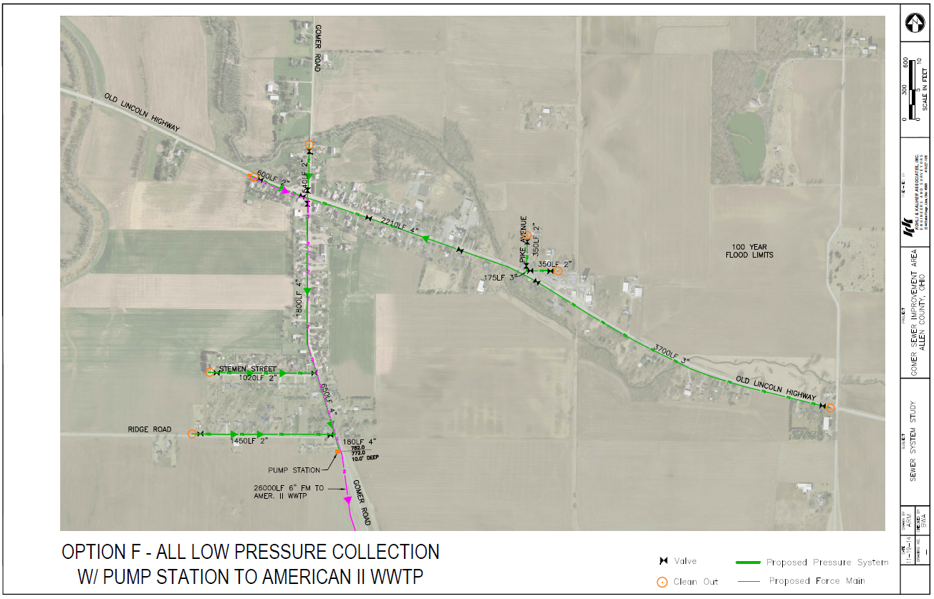
II. Project Layout & Pump Information
Notes:
Layout of all the properties involved in the project.

Slide 7

II. Project Layout & Pump Information
Low Pressure Collection Systems:
In addition to using these systems in rocky, hilly and wet areas our department will use these in areas where gravity collection systems are cost prohibitive, or in areas where major development expansion is not expected.

Slide 8
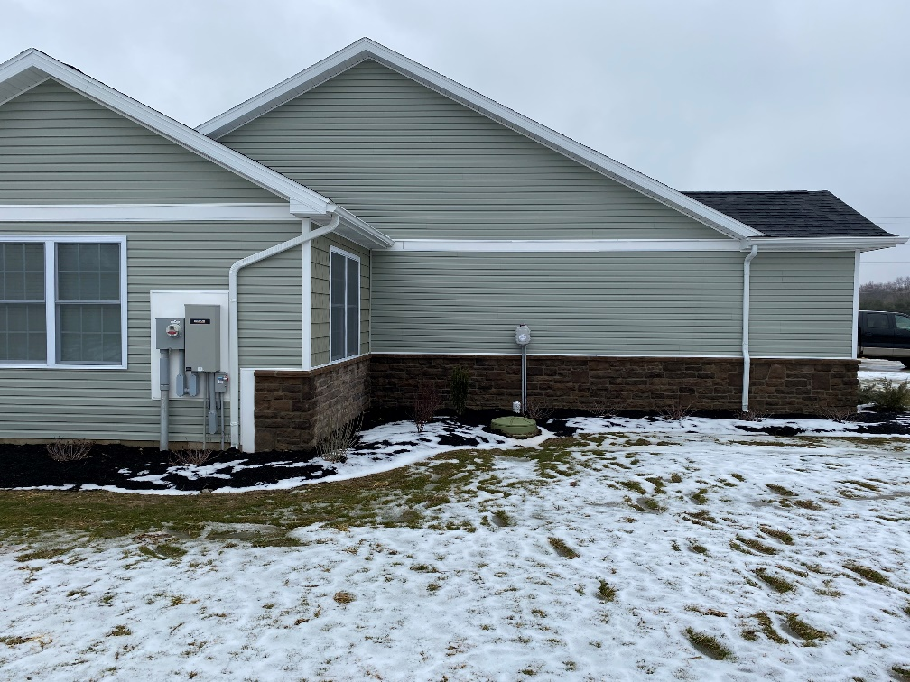
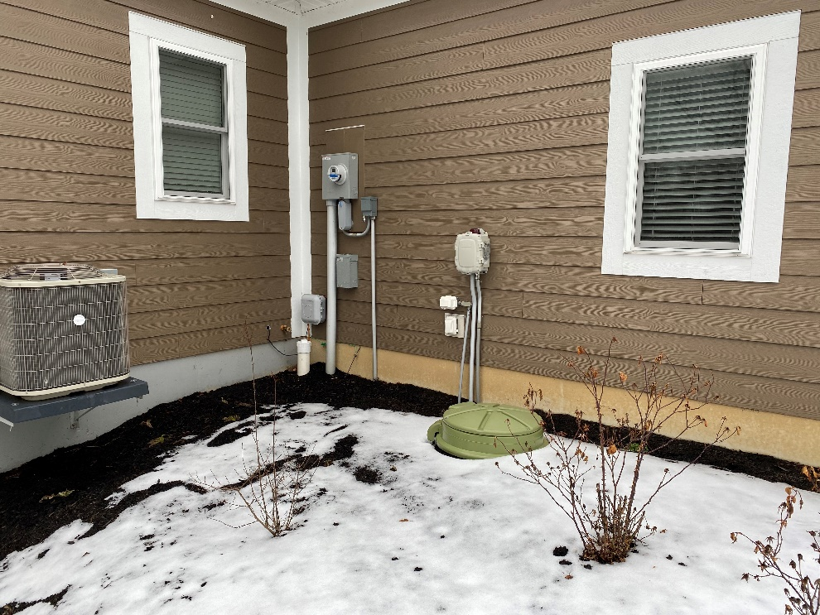
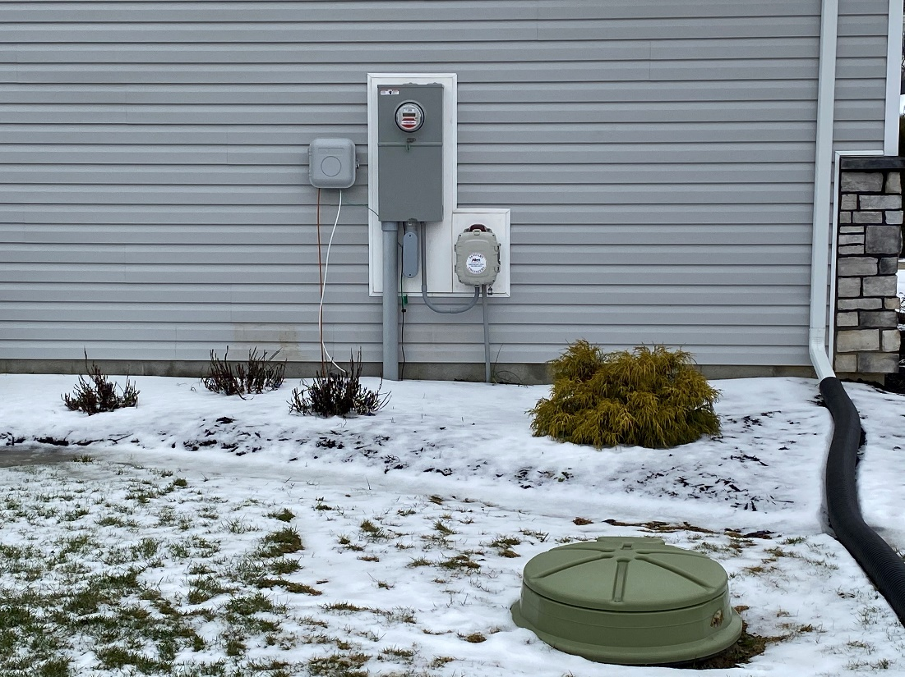
II. Project Layout & Pump Information
Typical E1 Installation Pics:

Slide 9
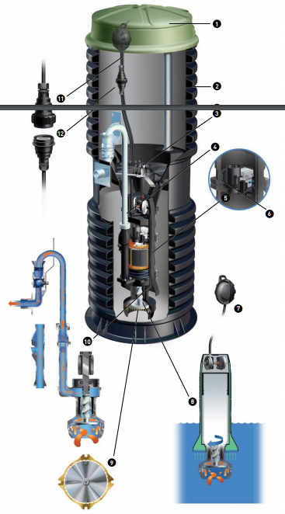

II. Project Layout & Pump Information
Glass, metal, abrasives, seafood shells, socks, rags, plastic, sanitary napkins, explosives, flammable materials, lubricating oils, greases, personal wipes and stormwater (no sump pumps or storm tiles).

Slide 10
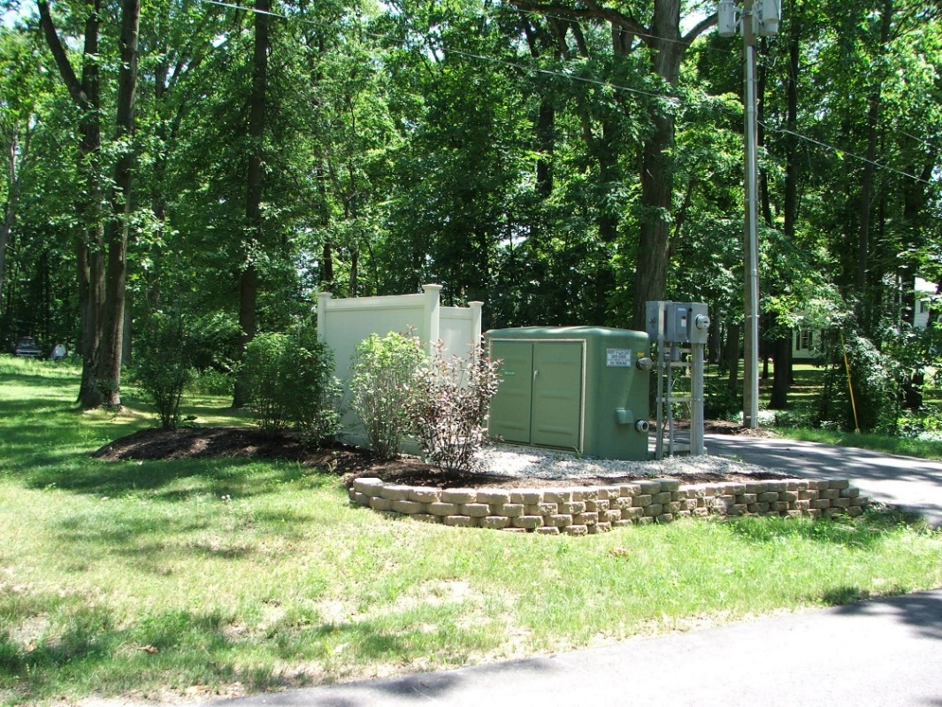
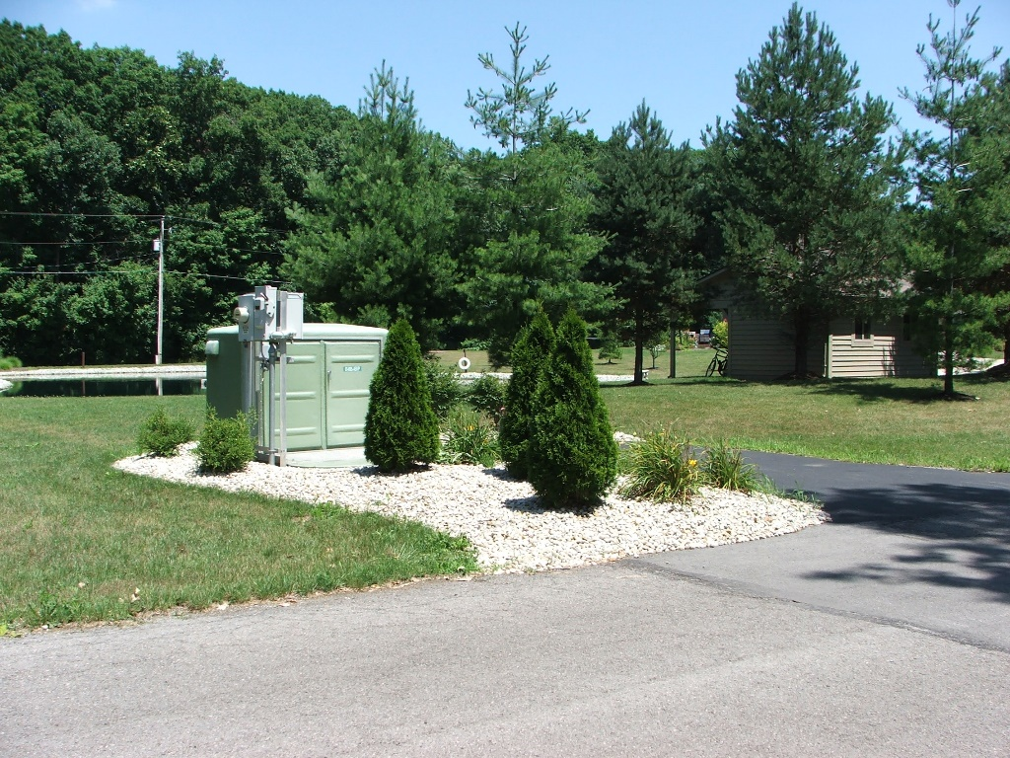
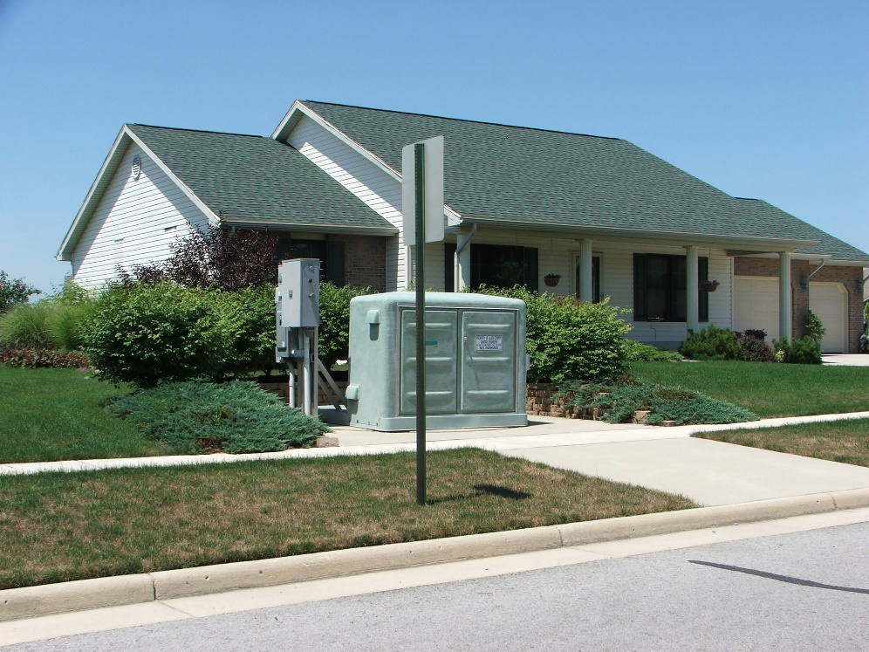
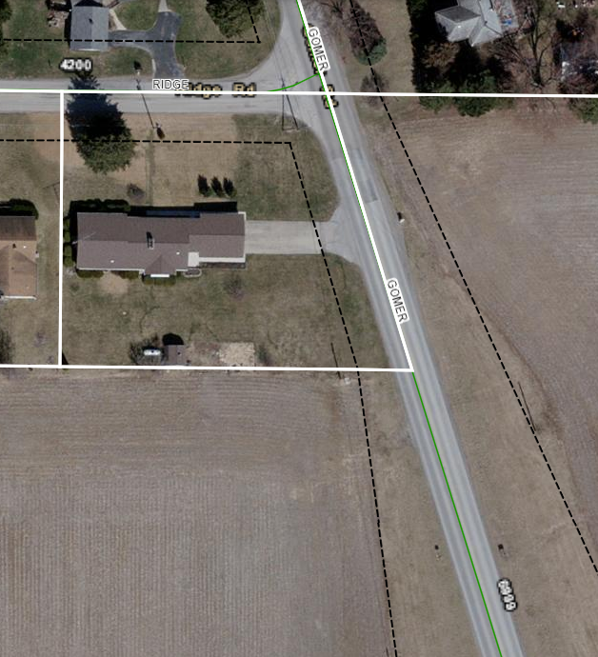
II. Project Layout & Pump Information
High Pressure Pump Station Pics:

Slide 11


III. Project Cost, Funding Assistance and Financing
Funding Assistance:
Funding has been established from the following agencies:
A $1.3 mill grant and $1.2 mill loan has been tentatively secured from United States Department of Agriculture.
A $500,000 grant has been received from the Ohio Department of Development HB 168
A $500,000 grant has been received from the Ohio Development Services Agency Community Development Block Grant (CDBG).
A $400,000 Revolving Loan Fund grant has been received from the Board of County Commissioners and State of Ohio.

Slide 12
III. Project Cost, Funding Assistance and Financing
GOMER SEWER IMPROVEMENT
USE AND SOURCE
USES | February 27, 2020 | March 15, 2022
Construction | $ 2,911,778.00 | $ 3,412.425.00
Engineering | $ 284,600.00 | $ 284,600.00
Land Acquisition | $ 20,000.00 | $ 6,255.00
Resident Project Representative | $ 60,000.00 | $ 60,000.00
Connection Assistance | - | $ 75,000.00
CDBG Administrative | - | $ 20,000.00
Miscellaneous | $ 40,000.00 | $ 40,000.00
Administrative | - | $ 30,000.00
Contingency | $ 291,778.00 | $ 366,242.00
TOTAL | $ 3,657,332.00 | $ 4,294,522.00
Notes:
Breakdown of costs to property owners.

Slide 13
III. Project Cost, Funding Assistance and Financing
SOURCES | February 27, 2020 | March 15, 2022
USDA Grant | $ 1,300,000.00 | $ 1,300,000.00
USDA Loan-Property Owner Debt Service | $ 1,200,000.00 | $ 1,200,000.00
CDBG | $ 750,000.00 | $ 500,000.00
Ohio Department of Development, HB 168 | - | $ 500,000.00
RLF-Board of County Commissioners | $ 150,000.00 | $ 400,000.00
WPCLF HSTS Assistance | - | $ 75,000.00
Sanitary Engineering Dept. | $ 52,673.00 | $ 366,522.00
TOTAL | $ 3,657,332.00 | $ 4,294,522.00

Slide 14
III. Project Cost, Funding Assistance and Financing
ESTIMATED SUMMARY OF COST
Principal Project Cost per ESFU (150.08), 40-yrs (monthly debt service) | On-Lot (out-of-pocket) | Quarterly Sewer Bill
Estimated-$8,000¹ Estimated-($23.21 per mo) | $500--$1,500² | $148.50
  ¹The Principal Project Cost per Household may be paid in cash, or charged to sewer bill as a debt service for a period of 40 years with interest at 1.75%. Notices will be mailed to property owners for billing principal debt service.
  ²There may be assistance through CDBG or others to assist with cost for LMI qualified property owners. Information will be given later prior to connection notice for these funds.

Slide 15
V. Post-Construction Connection Procedure
Connection Notice – Will be mailed to each property owner from the ACSE Department for connection to the project. The notice will include a window of time to pay principal debt service in cash or have it placed on your sewer bill for no more than 40 years.
Allen County Health District Home Inspection – A permit will need to be obtained (no-charge) from Allen County Health District to have their homes interior plumbing inspected by the health district prior obtaining a permit from the ACSE Department. At this time each property who feels they need assistance with connection cost due to a financial burden can make application to the Health Department to assist with cost of connection and abandonment of their on-site septic system through the WPCLF Connection Assistance Program.

Slide 16
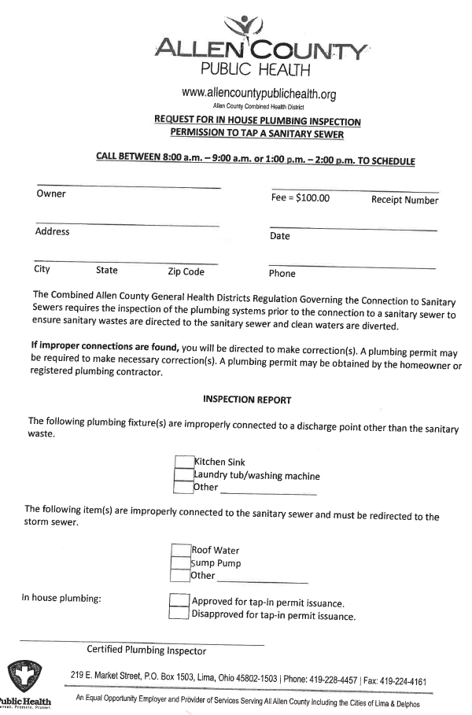
V. Post-Construction Connection Procedure
Health Department-Request for In-house Inspection

Slide 17
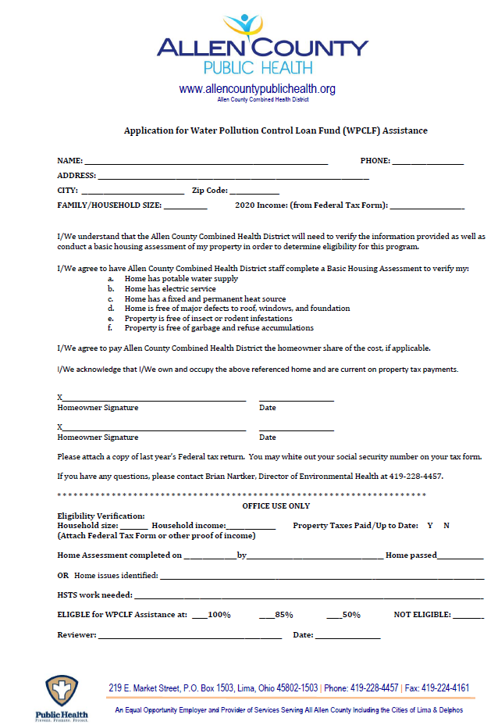
V. Post-Construction Connection Procedure
Health Department Application for WPCLF Connection Assistance

Slide 18
V. Post-Construction Connection Procedure
Property Owners obtain a no-charge Capital Permit from the ACSE Department. The Allen County Health District’s inspection form will be required to be presented at the time the Capital Permit is obtained from the ACSE Department.
Contractor Connection - The property owner will need to have their contractor connect to the sanitary sewer low pressure pump station. The property owner or their contractor will need to contact the ACSE Department 24 hours in advance of the property owner’s contractor commencing work to connect. All work by the contractor will need to be visually inspected prior to the contractor backfilling.

Slide 19
VI. Next Steps and Tentative Schedule
Info Meeting/CDBG 2nd Public Hearing – February 27, 2020
Start construction – April 2022
Substantial completion of construction – December 2022
Final billing and connection notice –March/April 2023
Wrap-up Meeting – May 2023
Complete final cleanup and reseeding – Spring/Summer 2023

